Slide 1
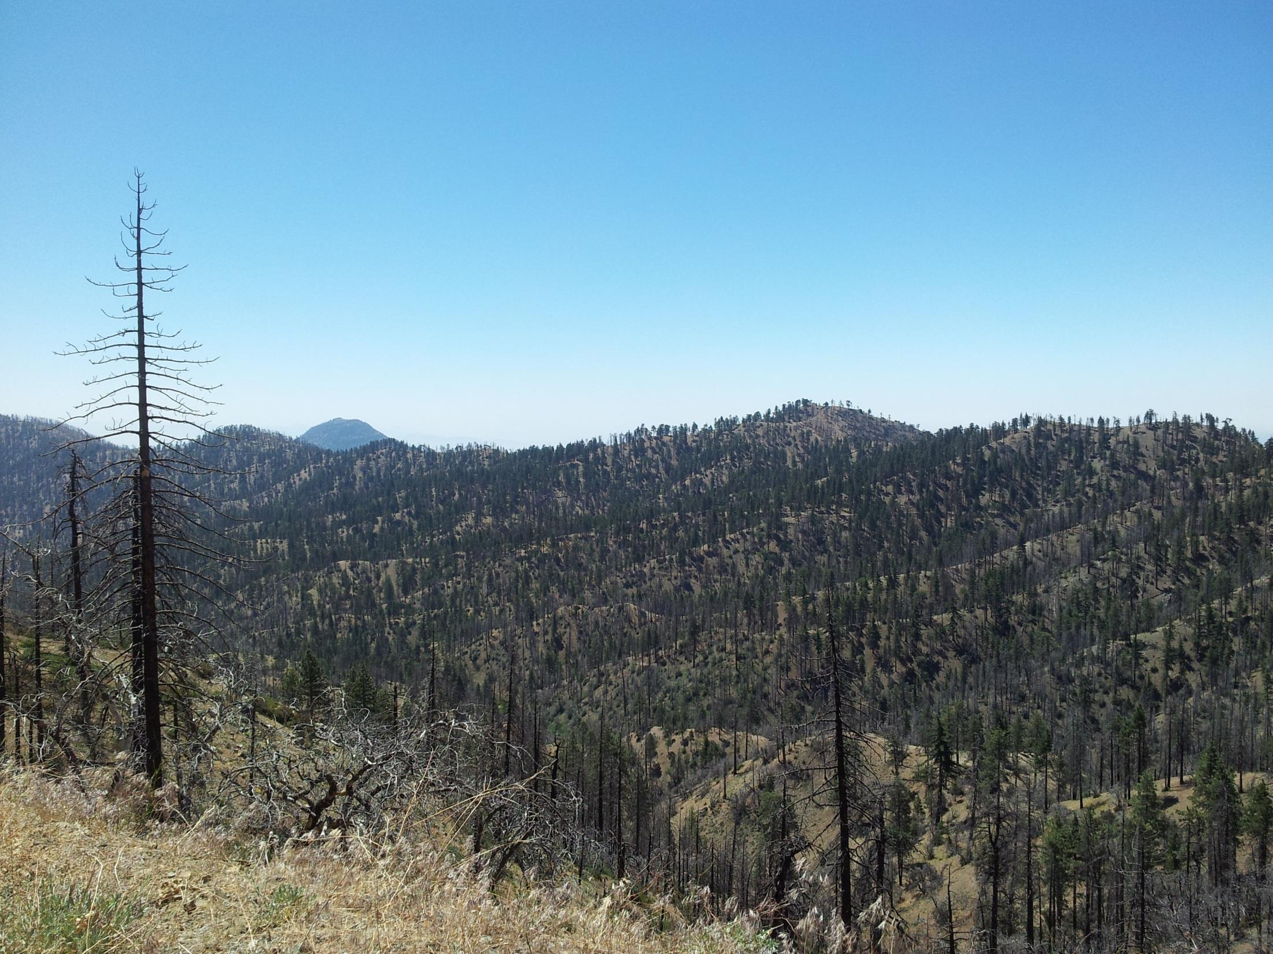


Objective extraction of channel heads from high resolution topographic data
Fiona Clubb¹, Simon Mudd¹,
David Milodowski¹, Martin Hurst², Louise Slater³
¹University of Edinburgh
²British Geological Survey ³University of St Andrews

Slide 2
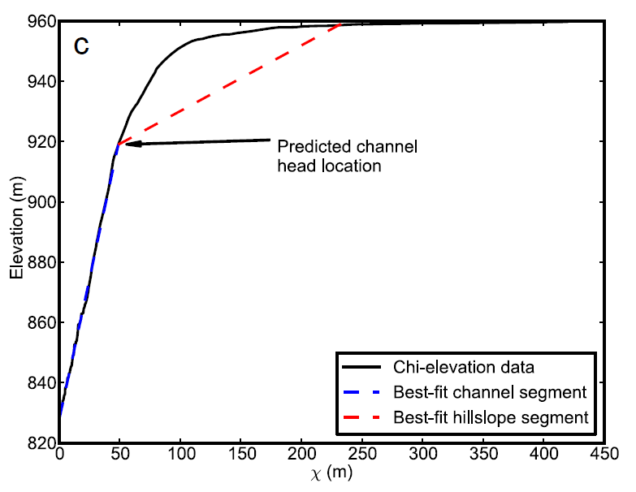
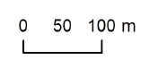
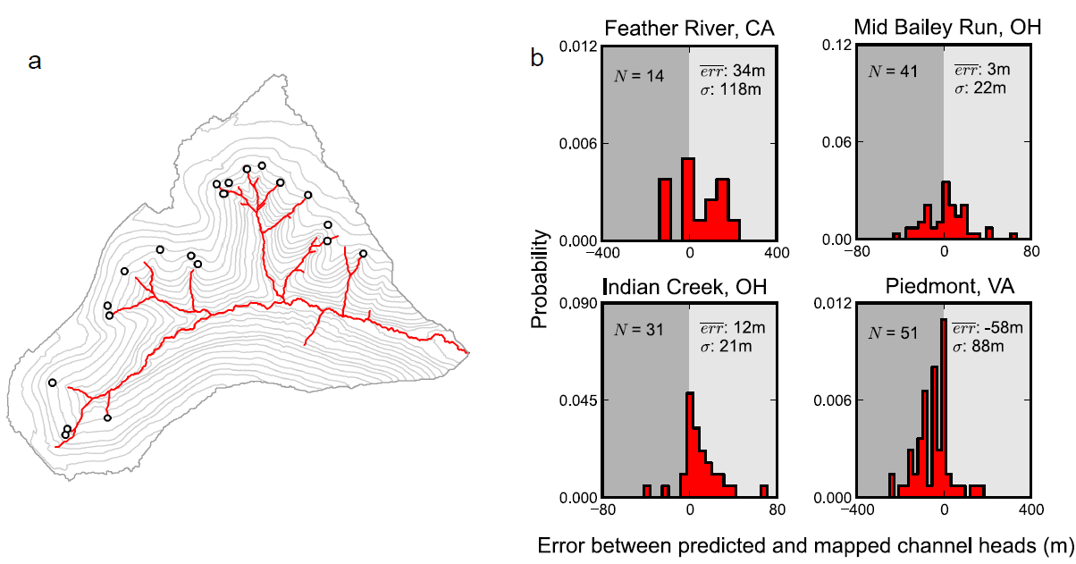
Drainage Extraction by Identifying Channel Heads (DrEICH):
A new algorithm for extracting channel networks
Chi plot showing predicted channel head location
Example drainage network resulting from DrEICH algorithm
Click to continue

Slide 3
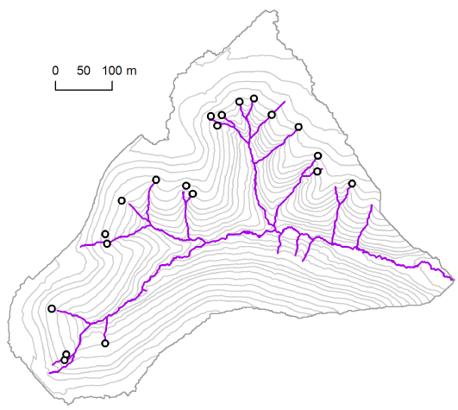
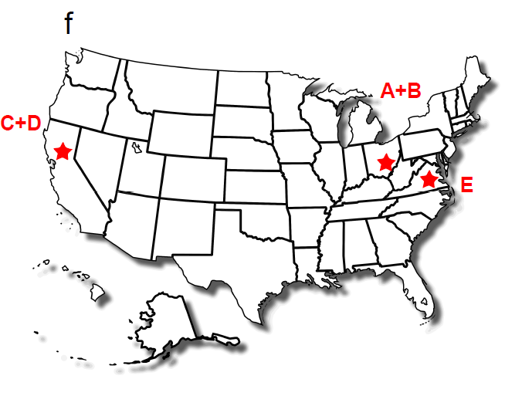
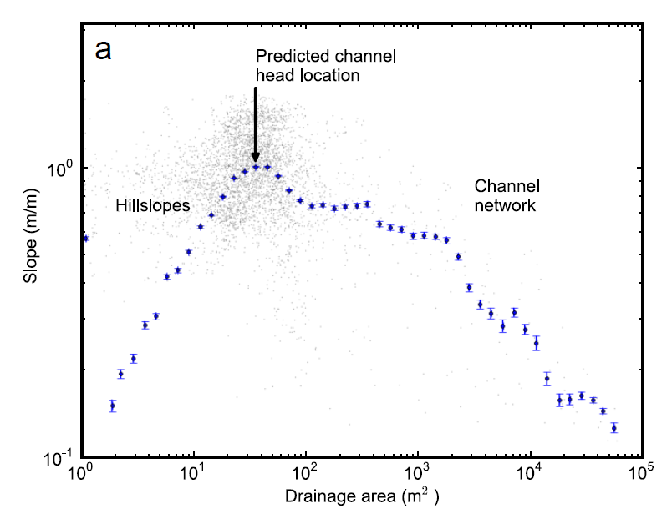
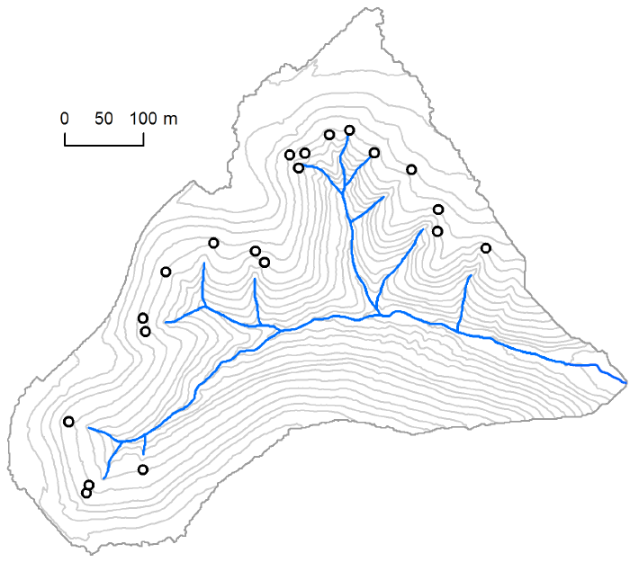
Testing different methods of extracting channel heads
Fiona Clubb, Simon Mudd, David Milodowski (Edinburgh), Martin Hurst (BGS), Louise Slater (St Andrews)
Field sites and channel head mapping
Click on an image below to view the methodology of each program as well as the results of testing against mapped channel heads from each field site. Home button can be used to go back to this slide.
Pelletier (2013)
Slope-area scaling relationships and thresholds
DrEICH algorithm
GeoNet 2.0

Slide 4
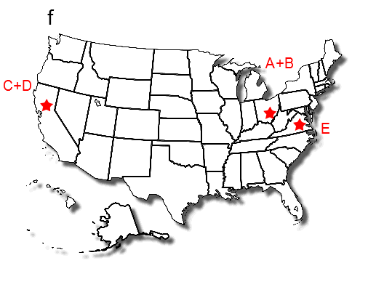
Field sites and channel head mapping
A total of 167 channel heads were mapped at 5 field sites across the USA
Indian Creek, Ohio
Mid Bailey Run, Ohio
Cascade Ridge, Feather River, California
Bald Rock Basin, Feather River, California
Piedmont, Virginia (data made publicly available by Julian et al., 2012)
1m LiDAR-generated DEMs were available for each field site
A+B
C+D
E
Click on letters above to view details about each field site
Use these buttons
to navigate the presentation
Channel head mapping

Slide 5
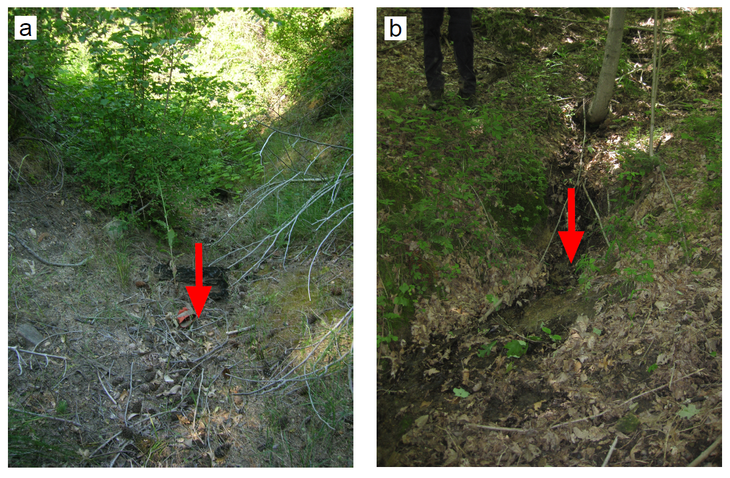
Field sites and channel head mapping
A channel head can be defined as: “the upslope limit of erosion and concentration of flow within steepened banks” (Montgomery and Dietrich, 1989)
Look for features such as:
Fluvial bedrock incision or polishing
Sorting of sediment
Alignment of pine needles along the flow direction
Valley shape
Feather River, California Mid Bailey Run, Ohio
Use these buttons
to navigate the presentation

Slide 6
Slope-area scaling relationships and thresholds
Methodology
Hillslope-valley transition is predicted to occur at the transition between fluvial and hillslope scaling.
Threshold values can be extracted by averaging the slope and drainage area at observed channel heads. Two different threshold values (T) were tested:
T = A where A is the mean drainage area of the mapped channel heads
T = AS² where S is the mean slope of the mapped channel heads
After Orlandini et al., 2011
Use these buttons
to navigate the presentation
Results of slope-area analysis

Slide 7
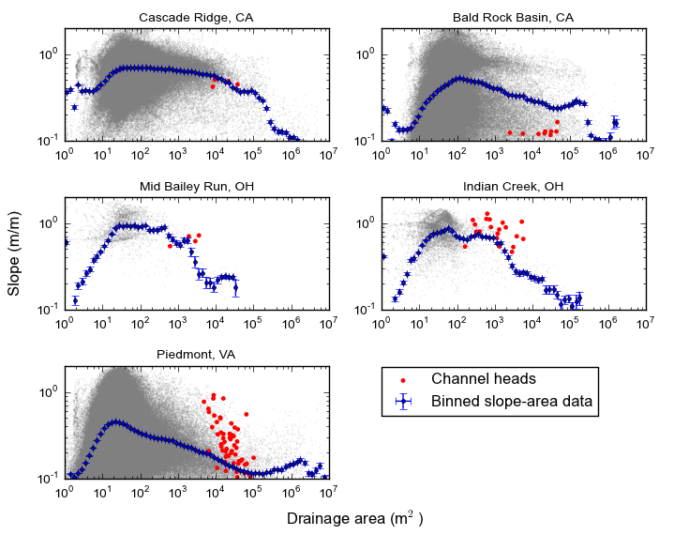
Slope-area scaling relationships and thresholds
Slope-area scaling relationships for each field site
Results for threshold values of A and AS²
The mean distance between mapped and predicted channel heads for each field site was calculated. Negative values indicate that the predicted channel head was upstream of the mapped.
Threshold value | Feather River | Mid Bailey Run | Indian Creek | Piedmont
A (m²) | 12262 | 413 | 1035 | 20816
AS² (m²) | 1805 | 278 | 640 | 1721
Error for A threshold(m) | -39 | -26 | -26 | -94
Error for AS² threshold(m) | -51 | -29 | -18 | -65
These results show that slope-area plots and thresholds are not effective at predicting channel head locations across the DEM. Furthermore, the calculation of the threshold values requires mapping of observed channel head locations.
Use these buttons
to navigate the presentation

Slide 8
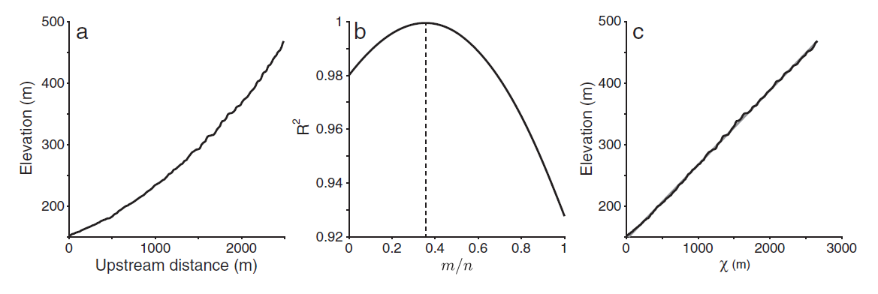
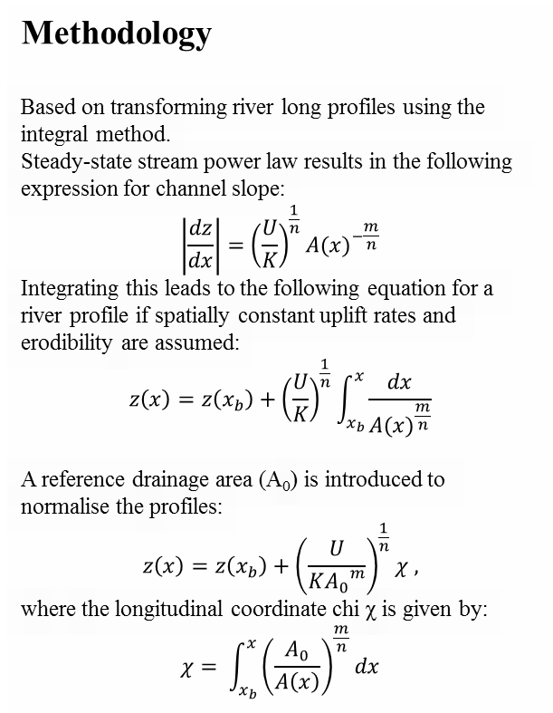
Drainage Extraction by Identifying Channel Heads (DrEICH)
Methodology
Based on transforming river long profiles using the integral method.
Steady-state stream power law results in the following expression for channel slope:
$$\left|\frac{dz}{dx}\right|={\left(\frac{U}{K}\right)}^{\frac{1}{n}}A{(x)}^{−\frac{m}{n}}$$
Integrating this leads to the following equation for a river profile if spatially constant uplift rates and erodibility are assumed:
$$z\left(x\right)=z\left(x_{b}\right)+{\left(\frac{U}{K}\right)}^{\frac{1}{n}}\int_{x_{b}}^{x}{\frac{dx}{A{(x)}^{\frac{m}{n}}}}$$
A reference drainage area (A₀) is introduced to normalise the profiles:
$$z\left(x\right)=z\left(x_{b}\right)+{\left(\frac{U}{K{A_{0}}^{m}}\right)}^{\frac{1}{n}}χ ,$$
where the longitudinal coordinate chi χ is given by:
$$χ= \int_{x_{b}}^{x}{{\left(\frac{A_{0}}{A\left(x\right)}\right)}^{\frac{m}{n}}}dx$$
Perron and Royden, 2012
DrEICH assumes the chi profile is made up of 2 segments: a linear channel segment and a non-linear hillslope segment.
Channel head is located at the transition point between the two segments.
Results of DrEICH algorithm
Navigate

Slide 9
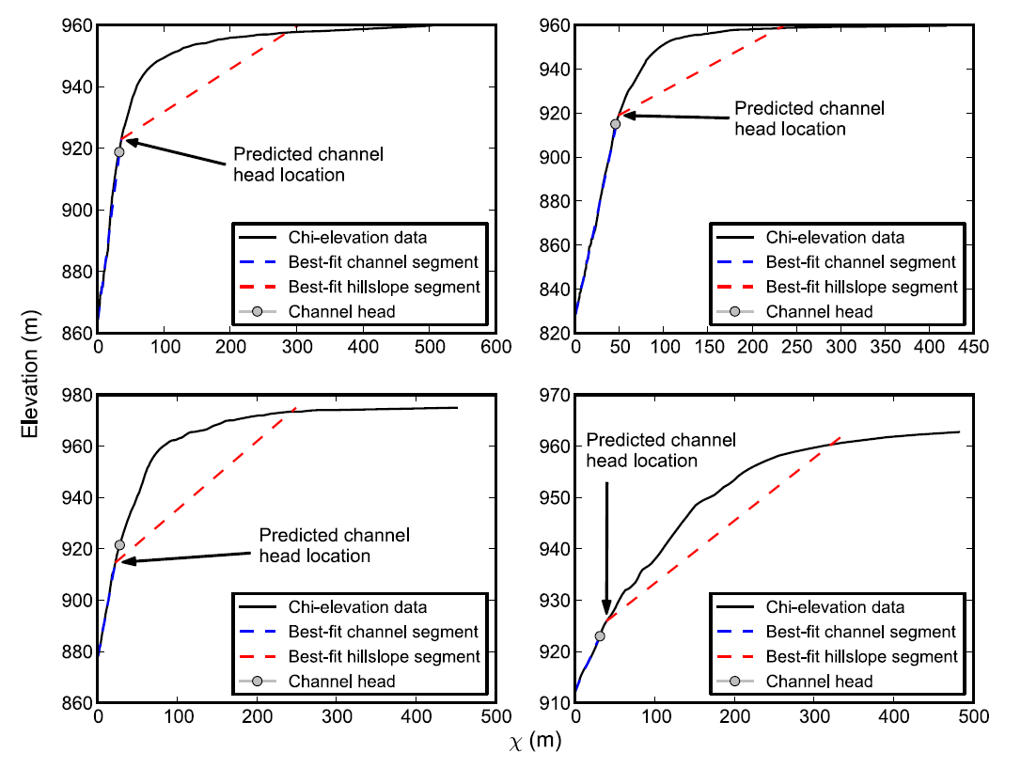
Drainage Extraction by Identifying Channel Heads (DrEICH)
Use these buttons
to navigate the presentation
Catchment-wide results of the DrEICH method
Back to methodology
Example chi plots for basins with mapped channel heads in Indian Creek, OH.

Slide 10
Drainage Extraction by Identifying Channel Heads (DrEICH)
Extracted drainage network for catchment of Indian Creek field site
Open circles indicate field-mapped channel heads. Drainage network predicted by DrEICH algorithm shown in red.
Click here for comparison with other methods
Distance between mapped and predicted channel heads
Grey shading indicates predicted channel heads upstream of the mapped
Click here for comparison with other methods
Sensitivity analysis
Navigate

Slide 11
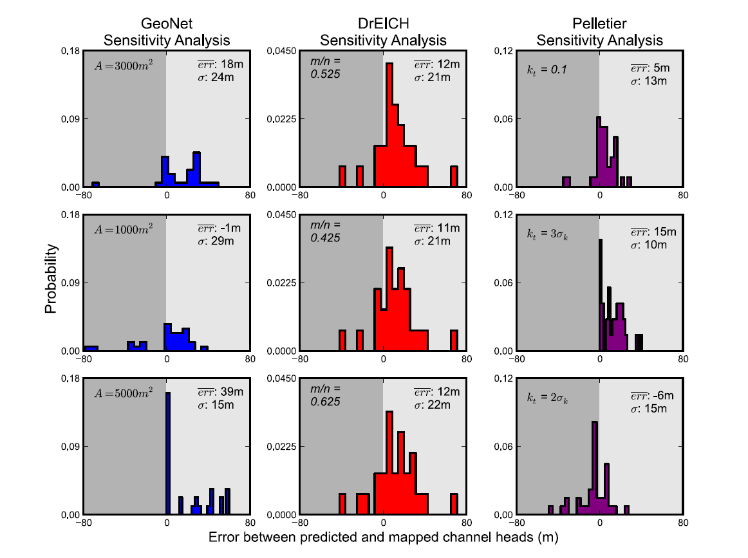
Drainage Extraction by Identifying Channel Heads (DrEICH)
Sensitivity analysis
What effect does varying the user-defined parameters have on the results?
Indian Creek field site: m/n value changed from 0.525 to 0.425 and 0.625
→ DrEICH algorithm is insensitive to changing m/n value
Navigate

Slide 12
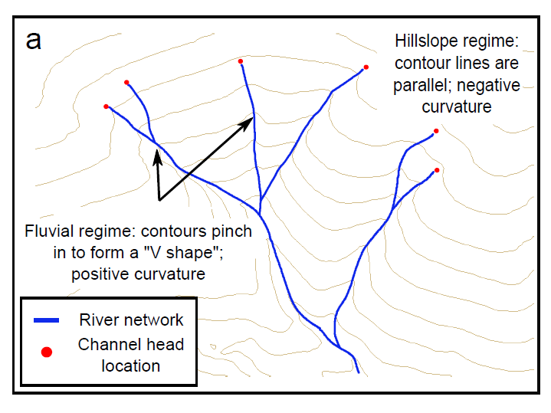
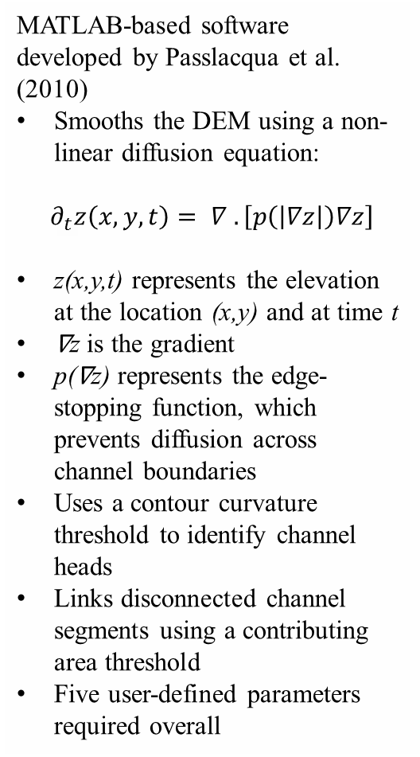
GeoNet 2.0: Methodology
MATLAB-based software developed by Passlacqua et al. (2010)
Smooths the DEM using a non-linear diffusion equation:
$$∂_{t}z\left(x,y,t\right)= ∇ . \left[p\left(\left|∇z\right|\right)∇z\right]$$
z(x,y,t) represents the elevation at the location (x,y) and at time t
∇z is the gradient
p(∇z) represents the edge-stopping function, which prevents diffusion across channel boundaries
Uses a contour curvature threshold to identify channel heads
Links disconnected channel segments using a contributing area threshold
Five user-defined parameters required overall
Contour curvature threshold illustrated above used by both GeoNet 2.0 and Pelletier (2013)
Navigate
GeoNet 2.0 results

Slide 13
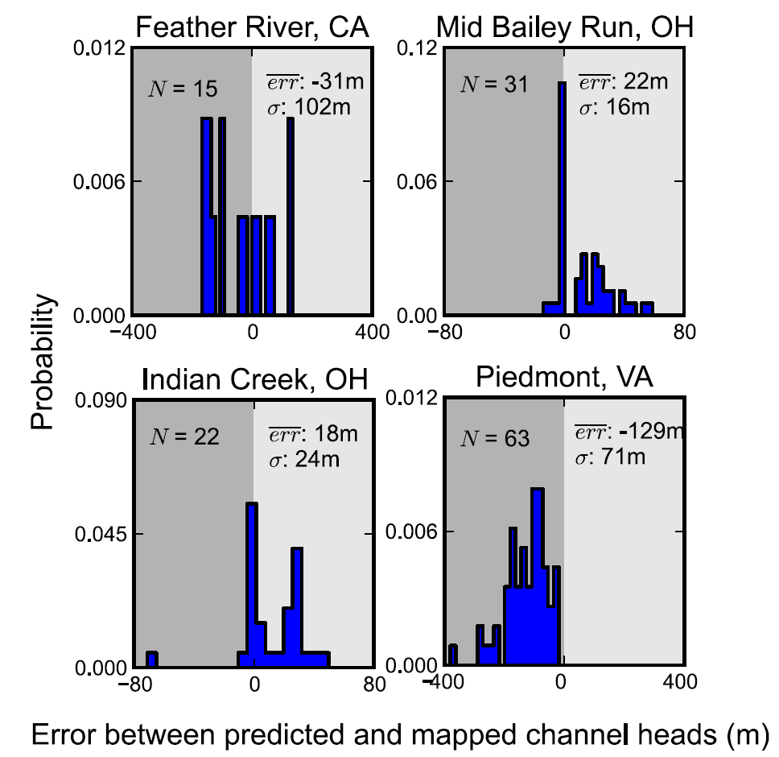
GeoNet 2.0: Results
Extracted drainage network for catchment of Indian Creek field site
Open circles indicate field-mapped channel heads. Drainage network predicted by GeoNet 2.0 shown in blue.
Click here for comparison with other methods
Distance between mapped and predicted channel heads
Grey shading indicates predicted channel heads upstream of the mapped
Click here for comparison with other methods
Navigate
Sensitivity analysis

Slide 14
GeoNet 2.0: Sensitivity Analysis
Sensitivity analysis
What effect does varying the user-defined parameters have on the results?
Indian Creek field site: contributing area threshold changed from 3000 m² to 1000 m² and 5000 m²
→ GeoNet is sensitive to changing the area threshold
Navigate

Slide 15
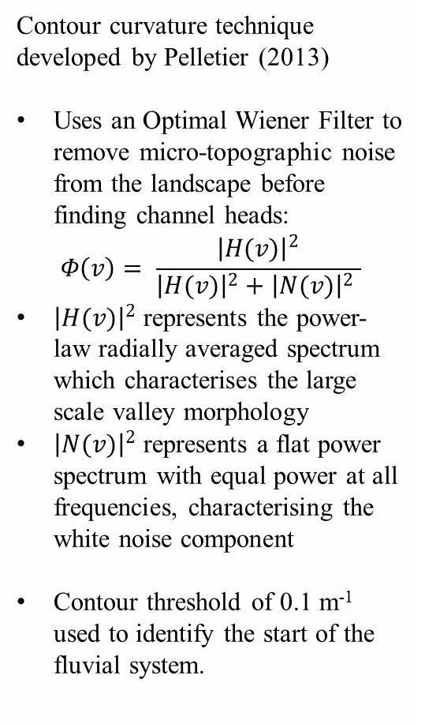
Pelletier (2013): Methodology
Contour curvature technique developed by Pelletier (2013)
Uses an Optimal Wiener Filter to remove micro-topographic noise from the landscape before finding channel heads:
$$Φ\left(v\right)= \frac{{\left|H(v)\right|}^{2}}{{\left|H(v)\right|}^{2}+{\left|N(v)\right|}^{2} }$$
${\left|H(v)\right|}^{2}$ represents the power-law radially averaged spectrum which characterises the large scale valley morphology
${\left|N(v)\right|}^{2}$ represents a flat power spectrum with equal power at all frequencies, characterising the white noise component
Contour threshold of 0.1 m⁻¹ used to identify the start of the fluvial system.
Contour curvature threshold illustrated above used by both GeoNet 2.0 and Pelletier (2013)
Navigate
Pelletier (2013) results

Slide 16
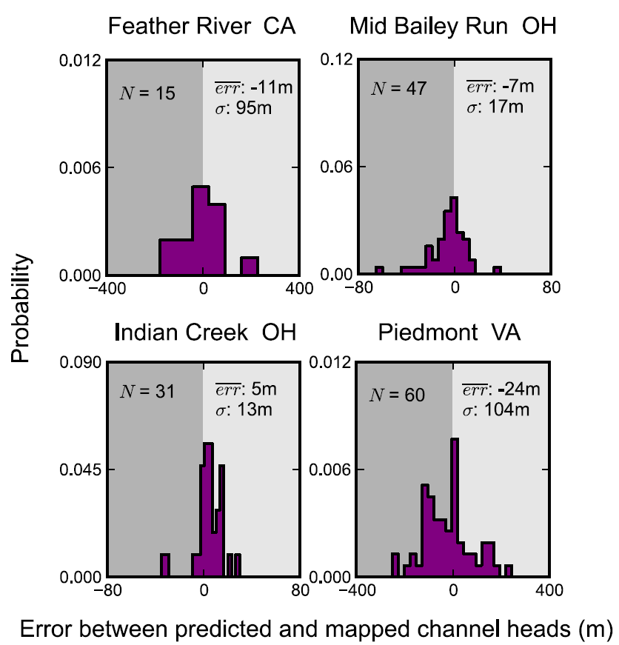
Pelletier (2013): Results
Extracted drainage network for catchment of Indian Creek field site
Open circles indicate field-mapped channel heads. Drainage network predicted by Pelletier (2013) shown in purple.
Click here for comparison with other methods
Distance between mapped and predicted channel heads
Grey shading indicates predicted channel heads upstream of the mapped
Click here for comparison with other methods
Navigate
Sensitivity analysis

Slide 17
Pelletier: Sensitivity Analysis
Sensitivity analysis
What effect does varying the user-defined parameters have on the results?
Indian Creek field site: contour curvature threshold changed from 0.1 m⁻¹ to multiples of the standard deviation of the curvature
→ Pelletier (2013) is sensitive to changing the curvature threshold
Navigate

Slide 18
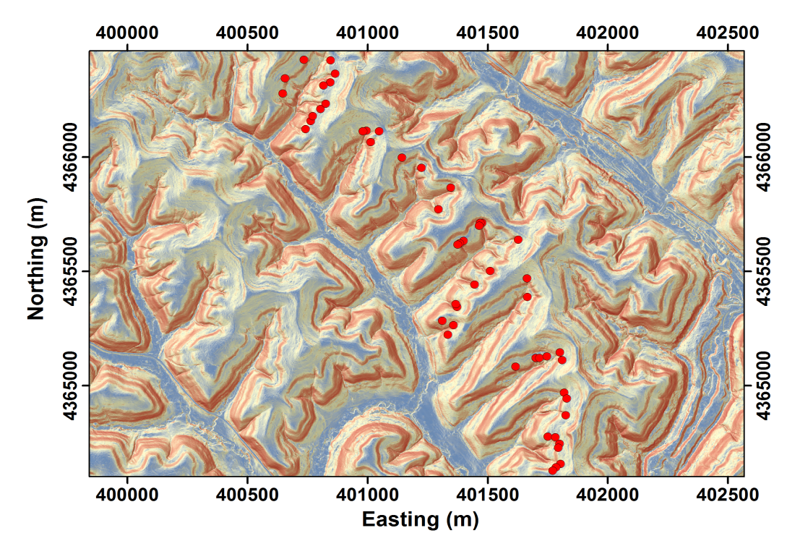
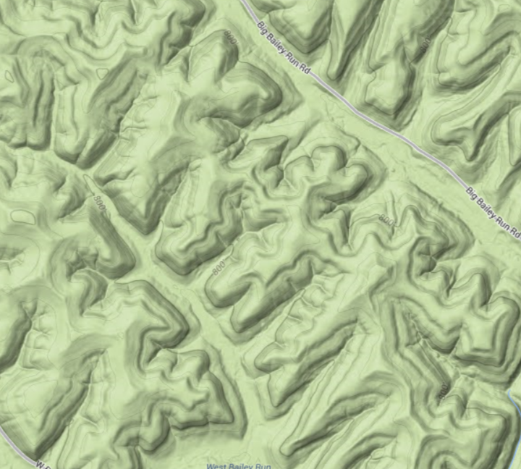
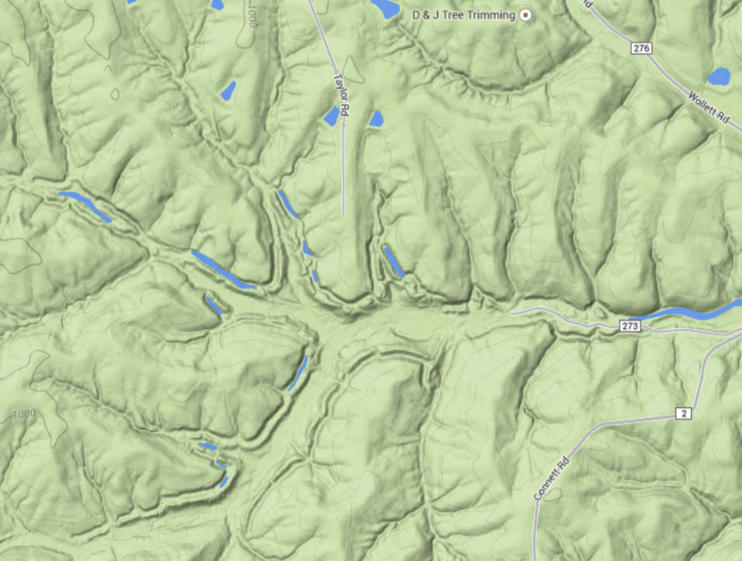
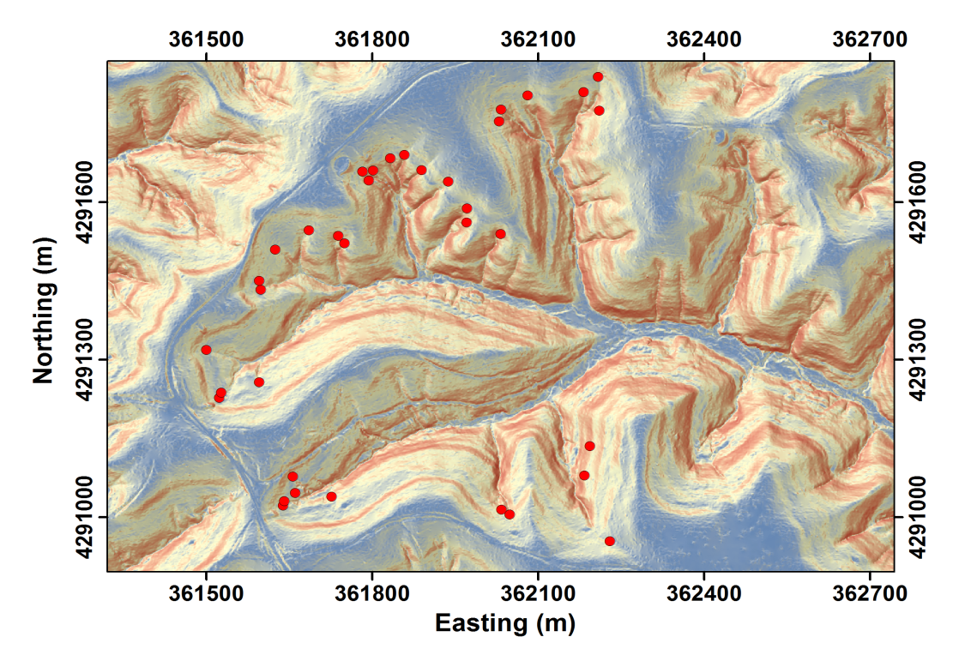
Click on images to open Google Maps
Field sites and channel head mapping
Mid Bailey Run, Ohio
A total of 167 channel heads were mapped at 5 field sites across the USA
Indian Creek, Ohio
Mid Bailey Run, Ohio
Cascade Ridge, Feather River, California
Bald Rock Basin, Feather River, California
Piedmont, Virginia (data made publicly available by Julian et al., 2012)
1m LiDAR-generated DEMs were available for each field site
A+B
C+D
Indian Creek, Ohio
E
Red circles: field mapped channel heads
Blue: low slopes
Red: high slopes
Back to map of field sites

Slide 19
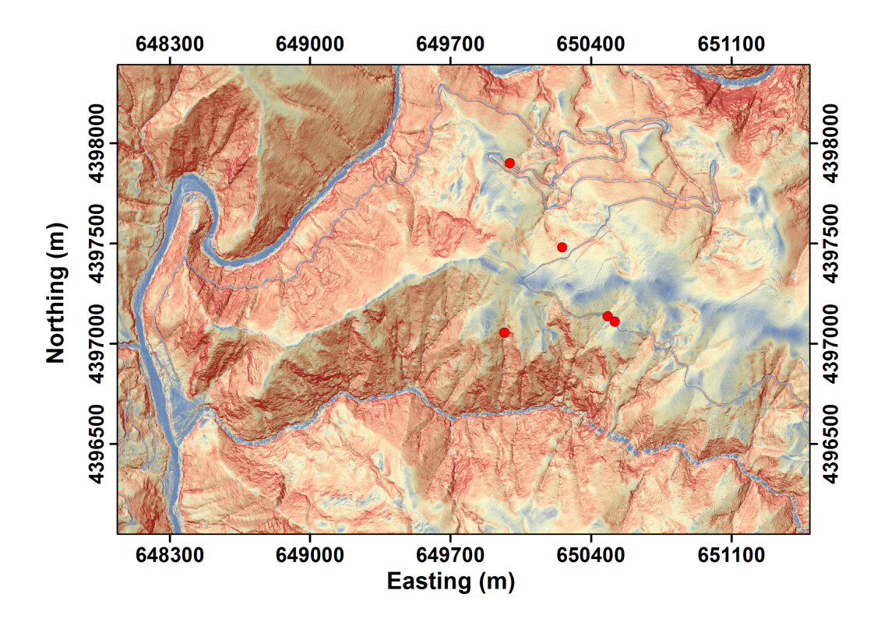
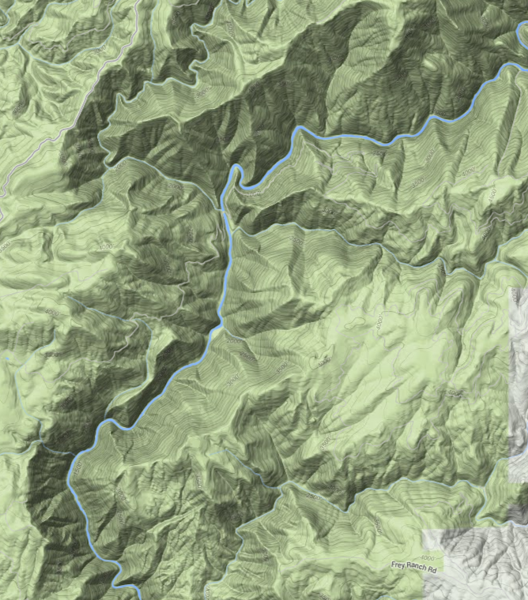
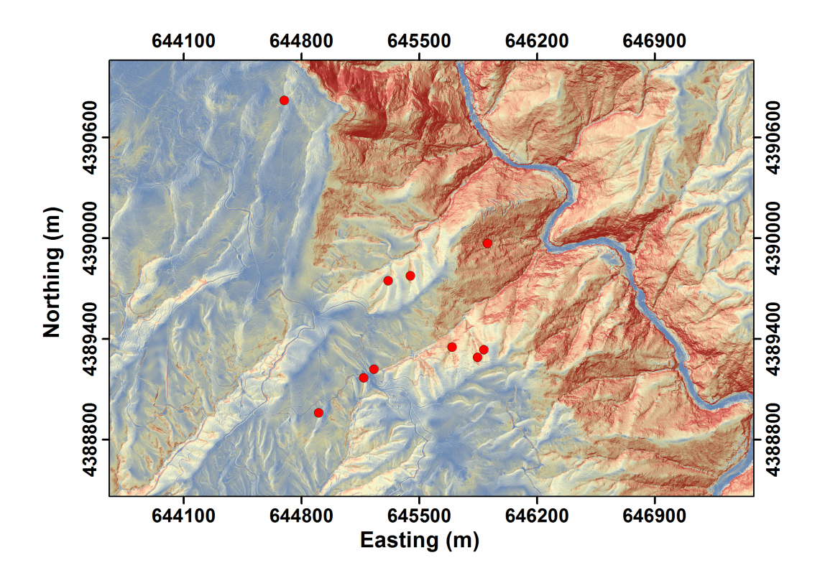
Field sites and channel head mapping
Feather River, California
A total of 167 channel heads were mapped at 5 field sites across the USA
Indian Creek, Ohio
Mid Bailey Run, Ohio
Cascade Ridge, Feather River, California
Bald Rock Basin, Feather River, California
Piedmont, Virginia (data made publicly available by Julian et al., 2012)
1m LiDAR-generated DEMs were available for each field site
A+B
C+D
E
Click on image to open Google Maps
Red circles: field mapped channel heads
Blue: low slopes
Red: high slopes
Back to map of field sites

Slide 20
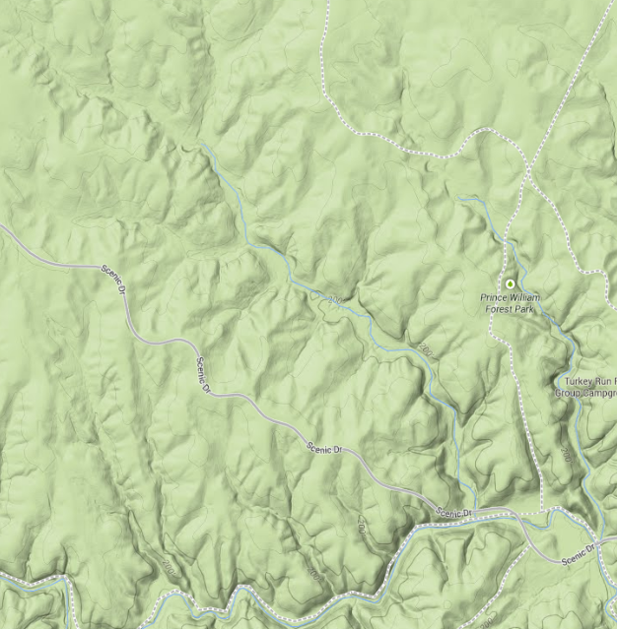
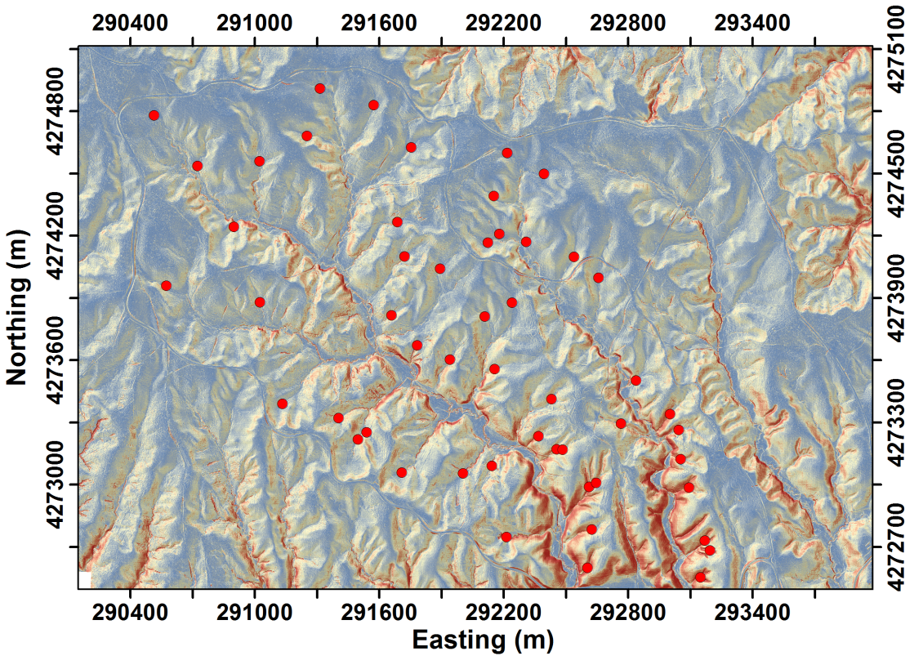
Field sites and channel head mapping
Piedmont, Virginia
A total of 167 channel heads were mapped at 5 field sites across the USA
Indian Creek, Ohio
Mid Bailey Run, Ohio
Cascade Ridge, Feather River, California
Bald Rock Basin, Feather River, California
Piedmont, Virginia (data made publicly available by Julian et al., 2012)
1m LiDAR-generated DEMs were available for each field site
Shaded slope map of Piedmont field site
A+B
C+D
E
Red circles: field mapped channel heads
Blue: low slopes
Red: high slopes
Click on image to open Google Maps
Back to map of field sites

Slide 21
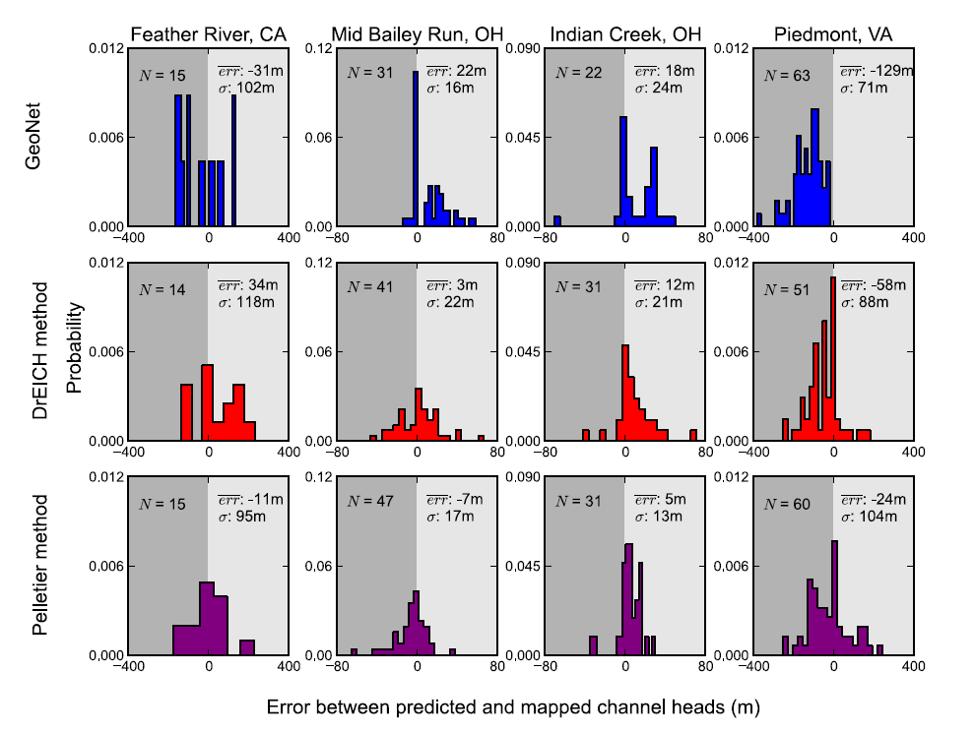
Comparison of Results: Error Histograms
Back to GeoNet method
Back to DrEICH method
Back to Pelletier method

Slide 22
Comparison of Results: Drainage Networks
GeoNet
DrEICH
Pelletier
Back to GeoNet method
Back to DrEICH method
Back to Pelletier method

